Slide 1
Advance Framework

Slide 2
Struts2
The struts 2 framework is used to develop MVC-based web application.
The Struts 2 framework is used to develop MVC (Model View Controller) based web applications. Struts 2 is the combination of webwork framework of opensymphony and struts 1.

Slide 3
Struts2
The Struts 2 provides supports to POJO based actions, Validation Support, AJAX Support, Integration support to various frameworks such as Hibernate, Spring, Tiles etc, support to various result types such as Freemarker, Velocity, JSP etc.

Slide 4
Struts2
Struts 2 Features
Configurable MVC components
In struts 2 framework, we provide all the components (view components and action) information in struts.xml file. If we need to change any information, we can simply change it in the xml file.

Slide 5
Struts2
POJO based actions
In struts 2, action class is POJO (Plain Old Java Object) i.e. a simple java class. Here, you are not forced to implement any interface or inherit any class.
AJAX support
Struts 2 provides support to ajax technology. It is used to make asynchronous request i.e. it doesn't block the user. It sends only required field data to the server side not all. So it makes the performance fast.

Slide 6
Struts2
Integration Support
We can simply integrate the struts 2 application with hibernate, spring, tiles etc. frameworks.
Various Tag support
Struts 2 provides various types of tags such as UI tags, Data tags, control tags etc to ease the development of struts 2 application.

Slide 7
Struts2
Model 1 Architecture
Servlet and JSP are the main technologies to develop the web applications.
Problem in Servlet technology Servlet needs to recompile if any designing code is modified. It doesn't provide separation of concern. Presentation and Business logic are mixed up.

Slide 8
Struts2
JSP overcomes almost all the problems of Servlet. It provides better separation of concern, now presentation and business logic can be easily separated. You don't need to redeploy the application if JSP page is modified. JSP provides support to develop web application using JavaBean, custom tags and JSTL so that we can put the business logic separate from our JSP that will be easier to test and debug.

Slide 9
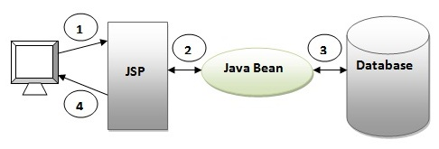
Struts2

Slide 10
Struts2
Disadvantage of Model 1 Architecture
Navigation control is decentralized since every page contains the logic to determine the next page. If JSP page name is changed that is referred by other pages, we need to change it in all the pages that leads to the maintenance problem.

Slide 11
Struts2
Model 2 (MVC) Architecture
Model 2 is based on the MVC (Model View Controller) design pattern. The MVC design pattern consists of three modules model, view and controller.
Model The model represents the state (data) and business logic of the application.
View The view module is responsible to display data i.e. it represents the presentation.
Controller The controller module acts as an interface between view and model. It intercepts all the requests i.e. receives input and commands to Model / View to change accordingly.

Slide 12
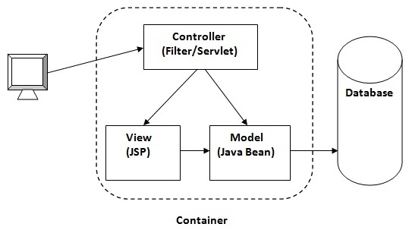
Struts2

Slide 13
Struts2
Disadvantage of Model 2 (MVC) Architecture
We need to write the controller code self. If we change the controller code, we need to recompile the class and redeploy the application.

Slide 14
Struts2
Solution of Model 2 Architecture: Configurable MVC Components
It uses the declarative approach for defining view components, request mapping etc. It resolves the problem of Model 2 architecture. The Struts framework provides the configurable MVC support. In struts 2, we define all the action classes and view components in struts.xml file.

Slide 15
Struts2
Struts 2 Interceptors
Interceptor is an object that is invoked at the preprocessing and post processing of a request. In Struts 2, interceptor is used to perform operations such as validation, exception handling, internationalization, displaying intermediate result etc.

Slide 16
Struts2
Advantage of interceptors
Pluggable If we need to remove any concern such as validation, exception handling, logging etc. from the application, we don't need to redeploy the application. We only need to remove the entry from the struts.xml file.

Slide 17
Struts2
Struts 2 default interceptors
checkbox It is used to handle the check boxes in the form. By this, we can detect the unchecked checkboxes.
cookie It adds a cookie to the current action.
debugging It provides support of debugging.

Slide 18
Struts2
exception It maps exception to a result.
jsonValidation It provides support to asynchronous validation.
params It populates the action properties with the request parameters.
validation It provides support to input validation.
workflow It calls the validate method of action class if action class implements Validateable interface.

Slide 19
Struts2
Struts 2 ValueStack
A valueStack is simply a stack that contains application specific objects such as action objects and other model object.
At the execution time, action is placed on the top of the stack.
We can put objects in the valuestack, query it and delete it.

Slide 20
Struts2
ValueStack Interface
The struts 2 framework provides an interface to deal with valuestack. It provides many useful methods.
public String findString(String expr) finds the string by evaluating the given expression.
public Object findValue(String expr) finds the value by evaluating the specified expression.

Slide 21
Struts2
public Object findValue(String expr, Class c) finds the value by evaluating the specified expression.
Struts 2 ActionContext
The ActionContext is a container of objects in which action is executed. The values stored in the ActionContext are unique per thread (i.e. ThreadLocal). So we don't need to make our action thread safe.

Slide 22
Struts2
We can get the reference of ActionContext by calling the getContext() method of ActionContext class.

Slide 23
Struts2
Struts 2 ActionInvocation
The ActionInvocation represents the execution state of an action. It holds the action and interceptors objects.
ActionInvocation Interface
The struts framework provides ActionInvocation interface to deal with ActionInvocation. It provides many methods, some of them can be used to get the instance of ValueStack, ActionProxy, ActionContext, Result etc

Slide 24
Struts2
public void invoke()
invokes the next resource in processing this ActionInvocation.
Struts 2 OGNL
The Object Graph Navigation Language (OGNL) is an expression language. It simplifies the accessibility of data stored in the ActionContext.

Slide 25
Struts2
The struts framework sets the ValueStack as the root object of OGNL. Notice that action object is pushed into the ValueStack. We can direct access the action property.
<s:property value="username"/>
The struts framework places other objects in ActionContext also e.g. map representing the request,session, application scopes.

Slide 26
Struts2
To get these values i.e. not the action property, we need to use # notation. For example to get the data from session scope, we need to use #session as given in the following example:
<s:property name="#session.username"/>

Slide 27
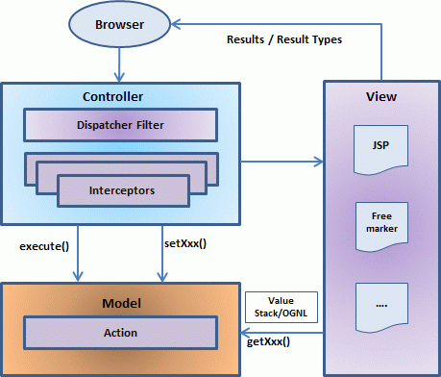
Struts2
Struts 2 Architecture

Slide 28
Struts2
User sends a request to the server for requesting for some resource (i.e pages).
The Filter looks at the request and then determines the appropriate Action.
Configured interceptors functionalities applies such as validation, file upload etc.
Selected action is executed to perform the requested operation.
Again, configured interceptors are applied to do any post-processing if required.
Finally the result is prepared by the view and returns the result to the user.

Slide 29
Struts2
Struts 2 Action
In struts 2, action class is POJO (Plain Old Java Object).
POJO means you are not forced to implement any interface or extend any class.
Generally, execute method should be specified that represents the business logic

Slide 30
Struts2
Action Interface
A convenient approach is to implement the com.opensymphony.xwork2.Action interface that defines 5 constants and one execute method.
5 Constants of Action Interface

Slide 31
Struts2
SUCCESS indicates that action execution is successful and a success result should be shown to the user.
ERROR indicates that action execution is failed and a error result should be shown to the user.
LOGIN indicates that user is not logged-in and a login result should be shown to the user.
INPUT indicates that validation is failed and a input result should be shown to the user again.
NONE indicates that action execution is successful but no result should be shown to the user.

Slide 32
Struts2
values are assigned to these constants.
public static final String SUCCESS = "success";
public static final String ERROR = "error";
public static final String LOGIN = "login";
public static final String INPUT = "input";
public static final String NONE = "none";

Slide 33
Struts2
Method of Action Interface
Action interface contains only one method execute that should be implemented overridden by the action class even if you are not forced.
public String execute();
ActionSupport class

Slide 34
Struts2
It is a convenient class that implements many interfaces such as Action, Validateable, ValidationAware, TextProvider, LocaleProvider and Serializable . So it is mostly used instead of Action.

Slide 35
Struts2
Struts 2 Configuration File
package element
We can easily divide our struts application into sub modules. The package element specifies a module. You can have one or more packages in the struts.xml file.
Attributes of package element

Slide 36
Struts2
name name is must for defining any package.
namespace It is an optional attribute of package. If namespace is not present, / is assumed as the default namespace. In such case, to invoke the action class, you need this URI:
/actionName.action

Slide 37
Struts2
If you specify any namespace, you need this URI:
/namespacename/actionName.action
extends The package element mostly extends the struts-default package where interceptors and result types are defined. If you extend struts-default, all the actions of this package can use the interceptors and result-types defined in the struts-default.xml file.

Slide 38
Struts2
action element
The action is the subelement of package and represents an action.
Attributes of action element
name name is must for defining any action.
class class is the optional attribute of action. If you omit the class attribute, ActionSupport will be considered as the default action. A simple action may be as:

Slide 39
Struts2
<action name="product">
method It is an optional attribute. If you don't specify method attribute, execute method will be considered as the method of action class.
<action name="product" class=“pack1.Product">

Slide 40
Struts2
will be same as:
<action name="product" class=“pack1.Product" method="execute">
If you want to invoke a particular method of the action, you need to use method attribute.

Slide 41
Struts2
result element
It is the sub element of action that specifies where to forward the request for this action.
Attributes of result element
name is the optional attribute. If you omit the name attribute, success is assumed as the default result name.
type is the optional attribute. If you omit the type attribute, dispatcher is assumed as the default result type

Slide 42
Results and Result Types
The dispatcher result type:
The dispatcher result type is the default type, and is used if no other result type is specified. It's used to forward to a servlet, JSP, HTML page, and so on, on the server. It uses the RequestDispatcher.forward()method.
The FreeMaker result type:

Slide 43
Results and Result Types
Freemaker is a popular templating engine that is used to generate output using predefined templates.
<result name="success“ type="freemarker">
The redirect result type:
The redirect result type calls the standard response.sendRedirect() method, causing the browser to create a new request to the given location.

Slide 44
Multiple Configuration File
For a large application, it is better to use multiple configuration file that one so that it may be easy to manage the application.
We can create many configuration files but we need to define it in the struts.xml file. The include sub-element of struts is used to define the supported configuration file.

Slide 45
Multiple Namespace
We can define multiple namespaces in struts.xml file by the namespace attribute of package element. As we know, default namespace is / (root).

Slide 46
Hibernate Framework
Hibernate framework simplifies the development of java application to interact with the database. Hibernate is an open source, lightweight, ORM (Object Relational Mapping) tool.
An ORM tool simplifies the data creation, data manipulation and data access. It is a programming technique that maps the object to the data stored in the database

Slide 47
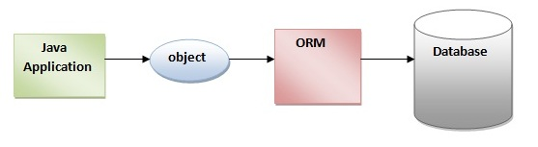
Hibernate Framework

Slide 48
Hibernate Framework
The ORM tool internally uses the JDBC API to interact with the database.
Advantages of Hibernate Framework
Opensource and Lightweight: Hibernate framework is opensource under the LGPL license and lightweight.
2) Fast performance: The performance of hibernate framework is fast because cache is internally used in hibernate framework. There are two types of cache in hibernate framework first level cache and second level cache. First level cache is enabled bydefault.

Slide 49
Hibernate Framework
Database Independent query: HQL (Hibernate Query Language) is the object-oriented version of SQL. It generates the database independent queries. So you don't need to write database specific queries. Before Hibernate, If database is changed for the project, we need to change the SQL query as well that leads to the maintenance problem.
4) Automatic table creation: Hibernate framework provides the facility to create the tables of the database automatically. So there is no need to create tables in the database manually

Slide 50
Hibernate Architecture
The Hibernate architecture includes many objects persistent object, session factory, transaction factory, connection factory, session, transaction etc.
There are 4 layers in hibernate architecture java application layer, hibernate framework layer, backhand api layer and database layer.Let's see the diagram of hibernate architecture:

Slide 51
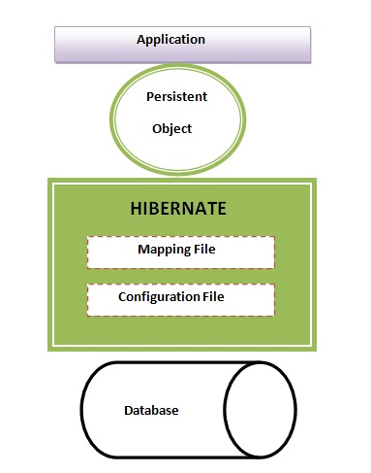
Hibernate Architecture

Slide 52
Hibernate Architecture
This is the high level architecture of Hibernate with mapping file and configuration file.
Hibernate framework uses many objects session factory, session, transaction etc. alongwith existing Java API such as JDBC (Java Database Connectivity), JTA (Java Transaction API) and JNDI (Java Naming Directory Interface).

Slide 53
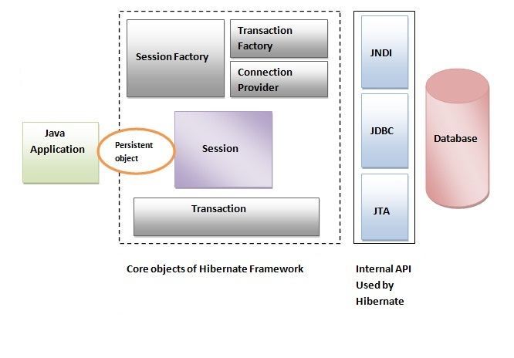
Hibernate Architecture

Slide 54
Elements of Hibernate Architecture
For creating the first hibernate application, we must know the elements of Hibernate architecture. They are as follows:
SessionFactory
The SessionFactory is a factory of session and client of ConnectionProvider. It holds second level cache (optional) of data. The org.hibernate.SessionFactory interface provides factory method to get the object of Session

Slide 55
Elements of Hibernate Architecture
Session
The session object provides an interface between the application and data stored in the database. It is a short-lived object and wraps the JDBC connection. It is factory of Transaction, Query and Criteria. It holds a first-level cache (mandatory) of data. The org.hibernate.Session interface provides methods to insert, update and delete the object. It also provides factory methods for Transaction, Query and Criteria.

Slide 56
Elements of Hibernate Architecture
Transaction
The transaction object specifies the atomic unit of work. It is optional. The org.hibernate.Transaction interface provides methods for transaction management.
ConnectionProvider
It is a factory of JDBC connections.

Slide 57
Elements of Hibernate Architecture
TransactionFactor
It is a factory of Transaction. It is optional.

Slide 58
Hibernate with Annotation
The hibernate application can be created with annotation. There are many annotations that can be used to create hibernate application such as @Entity, @Id, @Table etc.
Hibernate Annotations are based on the JPA 2 specification and supports all the features.
The core advantage of using hibernate annotation is that you don't need to create mapping (hbm) file. Here, hibernate annotations are used to provide the meta data

Slide 59
Hibernate with Annotation
@Entity annotation marks this class as an entity.
@Table annotation specifies the table name where data of this entity is to be persisted. If you don't use @Table annotation, hibernate will use the class name as the table name bydefault.
@Id annotation marks the identifier for this entity.
@Column annotation specifies the details of the column for this property or field. If @Column annotation is not specified, property name will be used as the column name bydefault

Slide 60
Generator classes in Hibernate
The <generator> subelement of id used to generate the unique identifier for the objects of persistent class. There are many generator classes defined in the Hibernate Framework.
All the generator classes implements the org.hibernate.id.IdentifierGenerator interface. The application programmer may create one's own generator classes by implementing the IdentifierGenerator interface. Hibernate framework provides many built-in generator classes.

Slide 61
Generator classes in Hibernate
assigned
increment
sequence
hilo
native
identity

Slide 62
Generator classes in Hibernate
assigned
It is the default generator strategy if there is no <generator> element . In this case, application assigns the id.
increment
It generates the unique id only if no other process is inserting data into this table. It generates short, intor long type identifier. The first generated identifier is 1 normally and incremented as 1.

Slide 63
Generator classes in Hibernate
sequence
It uses the sequence of the database. if there is no sequence defined, it creates a sequence automatically e.g. in case of Oracle database, it creates a sequence named HIBERNATE_SEQUENCE.
hilo
It uses high and low algorithm to generate the id of type short, int and long

Slide 64
Generator classes in Hibernate
native
It uses identity, sequence or hilo depending on the database vendor.
identity
It is used in Sybase, My SQL, MS SQL Server, DB2 and HypersonicSQL to support the id column. The returned id is of type short, int or long.
seqhilo
It uses high and low algorithm on the specified sequence name. The returned id is of type short, int or long.

Slide 65
SQL Dialects in Hibernate
For connecting any hibernate application with the database, you must specify the SQL dialects. There are many Dialects classes defined for RDBMS in the org.hibernate.dialect package.

Slide 66
Hibernate Inheritance Mapping
We can map the inheritance hierarchy classes with the table of the database. There are three inheritance mapping strategies defined in the hibernate:
Table Per Hierarchy
Table Per Concrete class
Table Per Subclass
Table Per Hierarchy
By this inheritance strategy, we can map the whole hierarchy by single table only. Here, an extra column (also known as discriminator column) is created in the table to identify the class

Slide 67
Hibernate Inheritance Mapping
In case of table per class hierarchy an discriminator column is added by the hibernate framework that specifies the type of the record. It is mainly used to distinguish the record. To specify this, discriminator subelement of class must be specified.
The subclass subelement of class, specifies the subclass.
Table Per Concrete class

Slide 68
Hibernate Inheritance Mapping
In case of Table Per Concrete class, there will be three tables in the database having no relations to each other.
In case of table per concrete class, there will be three tables in the database, each representing a particular class.
The union-subclass subelement of class, specifies the subclass. It adds the columns of parent table into child table. In other words, it is working as a union.

Slide 69
Hibernate Inheritance Mapping
Table Per Subclass
In case of Table Per Subclass, subclass mapped tables are related to parent class mapped table by primary key and foreign key relationship.
The <joined-subclass> element of class is used to map the child class with parent using the primary key and foreign key relation.
In case of table per subclass class, there will be three tables in the database, each representing a particular class.
The joined-subclass subelement of class, specifies the subclass. The key subelement of joined-subclass is used to generate the foreign key in the subclass mapped table. This foreign key will be associated with the primary key of parent class mapped table.

Slide 70
Collection Mapping
We can map collection elements of Persistent class in Hibernate. You need to declare the type of collection in Persistent class from one of the following types:
java.util.List
java.util.Set
java.util.SortedSet
java.util.Map
java.util.SortedMap
java.util.Collection
or write the implementation of org.hibernate.usertype.UserCollectionType

Slide 71
Collection Mapping
They are <list>, <bag>, <set>and <map>.
<key> element is used to define the foreign key in this table based on the Question class identifier.
<index> element is used to identify the type. List and Map are indexed collection.
<element> is used to define the element of the collection.
if collection stores entity reference (another class objects), we need to define <one-to-many> or <many-to-many> element.
The bag is just like List but it doesn't require index element.

Slide 72
Collection Mapping
Indexed collections
The collection elements can be categorized in two forms:
indexed ,and
non-indexed
The List and Map collection are indexed whereas set and bag collections are non-indexed. Here, indexed collection means List and Map requires an additional element <index>.
Collection Elements

Slide 73
Collection Mapping
The collection elements can have value or entity reference (another class object). We can use one of the 4 elements
element
component-element
one-to-many, or
many-to-many
The element and component-element are used for normal value such as string, int etc. whereas one-to-many and many-to-many are used to map entity reference.

Slide 74
Spring Framework
Spring is a lightweight framework. It can be thought of as a framework of frameworks because it provides support to various frameworks such as Struts, Hibernate,EJB, JSF etc.
Inversion Of Control (IOC) and Dependency Injection
These are the design patterns that are used to remove dependency from the programming code. They make the code easier to test and maintain. Let's understand this with the following code:

Slide 75
Spring Framework
class Employee{
Address address;
Employee(){
address=new Address();
}
}
In such case, there is dependency between the Employee and Address (tight coupling). In the Inversion of Control scenario, we do this something like this:

Slide 76
Spring Framework
class Employee{
Address address;
Employee(Address address){
this.address=address;
}
}
Thus, IOC makes the code loosely coupled. In such case.
In Spring framework, IOC container is responsible to inject the dependency. We provide metadata to the IOC container either by XML file or annotation.

Slide 77
Spring Framework
Advantage of Dependency Injection
makes the code loosely coupled so easy to maintain
makes the code easy to test.
Spring Modules
The Spring framework comprises of many modules such as core, beans, context, expression language, AOP, Aspects, JDBC, ORM, JMS, Transaction, Web, Servlet, Struts etc. These modules are grouped into Test, Core Container, AOP, Aspects, Instrumentation, Data Access / Integration, Web (MVC / Remoting) as displayed in the following diagram.

Slide 78
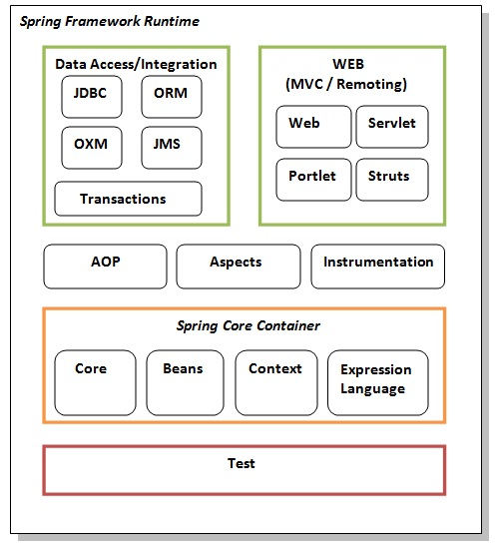
Spring Framework

Slide 79
Spring Framework
Test
This layer provides support of testing with JUnit and TestNG.
Spring Core Container
The Spring Core container contains core, beans, context and expression language (EL) modules.
Core and Beans
These modules provide IOC and Dependency Injection features.
Context
This module supports internationalization (I18N), EJB, JMS, Basic Remoting.

Slide 80
Spring Framework
Expression Language
It is an extension to the EL defined in JSP.
AOP, Aspects and Instrumentation
These modules support aspect oriented programming implementation where you can use Advices, Pointcuts etc. to decouple the code.
The aspects module provides support to integration with AspectJ.
The instrumentation module provides support to class instrumentation and classloader implementations.

Slide 81
Spring Framework
Data Access / Integration
This group comprises of JDBC, ORM, OXM, JMS and Transaction modules. These modules basically provide support to interact with the database.
Web
These modules provide support to create web application.
IoC Container
The IoC container is responsible to instantiate, configure and assemble the objects. The IoC container gets informations from the XML file and works accordingly.

Slide 82
Spring Framework
The main tasks performed by IoC container are:
to instantiate the application class
to configure the object
to assemble the dependencies between the objects.
There are two types of IoC containers. They are:
BeanFactory
ApplicationContext
Difference between BeanFactory and the ApplicationContext
The org.springframework.beans.factory.BeanFactory and the org.springframework.context.ApplicationContext interfaces acts as the IoC container. The ApplicationContext interface is built on top of the BeanFactory interface. It adds some extra functionality than BeanFactory such as simple integration with Spring's AOP, message resource handling (for I18N).

Slide 83
Spring Framework
Using BeanFactory
The XmlBeanFactory is the implementation class for the BeanFactory interface. To use the BeanFactory, we need to create the instance of XmlBeanFactory class as given below:
Resource resource=new ClassPathResource("applicationContext.xml");
BeanFactory factory=new XmlBeanFactory(resource);
The constructor of XmlBeanFactory class receives the Resource object so we need to pass the resource object to create the object of BeanFactory.

Slide 84
Spring Framework
Using ApplicationContext
The ClassPathXmlApplicationContext class is the implementation class of ApplicationContext interface. We need to instantiate the ClassPathXmlApplicationContext class to use the ApplicationContext as given below:
ApplicationContext context =
new ClassPathXmlApplicationContext("applicationContext.xml");
The constructor of ClassPathXmlApplicationContext class receives string, so we can pass the name of the xml file to create the instance of ApplicationContext.

Slide 85
Spring Framework
Dependency Injection in Spring
Dependency Injection (DI) is a design pattern that removes the dependency from the programming code so that it can be easy to manage and test the application. Dependency Injection makes our programming code loosely coupled.
Dependency Injection
In such case we provide the information from the external source such as XML file.
class Employee{
Address address;
Employee(Address address){
this.address=address;
}
public void setAddress(Address address){
this.address=address;
} }

Slide 86
Spring Framework
In such case, instance of Address class is provided by external souce such as XML file either by constructor or setter method.
Two ways to perform Dependency Injection in Spring framework
Spring framework provides two ways to inject dependency
By Constructor
By Setter method
Dependency Injection by Constructor
We can inject the dependency by constructor. The <constructor-arg> subelement of <bean> is used for constructor injection

Slide 87
Spring Framework
You can inject
primitive and String-based values
Dependent object (contained object)
Collection values etc.
Constructor Injection with Dependent Object
If there is HAS-A relationship between the classes, we create the instance of dependent object (contained object) first then pass it as an argument of the main class constructor. Here, our scenario is Employee HAS-A Address. The Address class object will be termed as the dependent object.

Slide 88
Spring Framework
<constructor-arg>
<ref bean="a1"/>
</constructor-arg>
Constructor Injection with Collection
We can inject collection values by constructor in spring framework. There can be used three elements inside the constructor-arg element.
It can be:
list
set
map
Each collection can have string based and non-string based values.

Slide 89
Spring Framework
Constructor Injection with Non-String Collection (having Dependent Object)
<list>
<ref bean="ans1"/>
<ref bean="ans2"/>
</list>
Inheriting Bean
By using the parent attribute of bean, we can specify the inheritance relation between the beans. In such case, parent bean values will be inherited to the current bean.

Slide 90
Spring Framework
Dependency Injection by setter method
We can inject the dependency by setter method also. The <property> subelement of <bean> is used for setter injection.you can inject
primitive and String-based values
Dependent object (contained object)
Collection values etc.
Difference between constructor and setter injection

Slide 91
Spring Framework
Partial dependency: can be injected using setter injection but it is not possible by constructor. Suppose there are 3 properties in a class, having 3 arg constructor and setters methods. In such case, if you want to pass information for only one property, it is possible by setter method only.
Overriding: Setter injection overrides the constructor injection. If we use both constructor and setter injection, IOC container will use the setter injection.
Changes: We can easily change the value by setter injection. It doesn't create a new bean instance always like constructor. So setter injection is flexible than constructor injection.

